Slide 1
ELECTRICAL SCIENCE-1
(15B11EC111)
UNIT-2
Lecture-3

Slide 2
Topics to be Discussed
Mesh analysis
Numericals
References

Slide 3
Mesh Analysis

Slide 4
Mesh Analysis
Mesh is a loop which contains no other loop within it.
Mesh analysis is applicable only to a planar network.
Meshes provide a set of independent equations.
The mesh analysis not only tell us the minimum number of unknown currents, but it also ensures that the KVL equations obtained are independent.

Slide 5
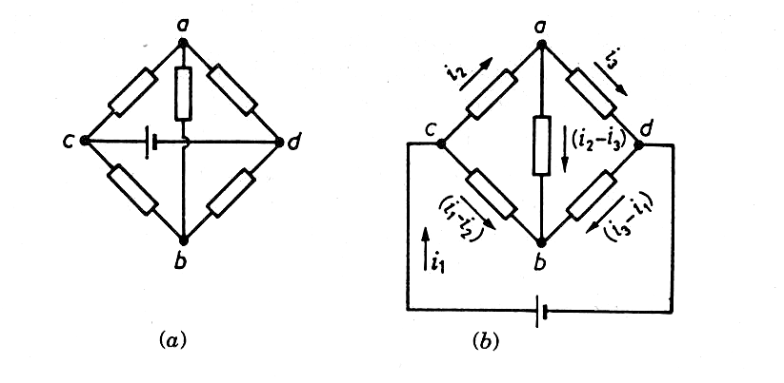
Planar Network
If a network can be drawn on sheet of paper without crossing lines, it is said to be planar.
Is it a planar network ?
Yes, it is. Because it can be drawn in a plane, as shown in the next figure.

Slide 7
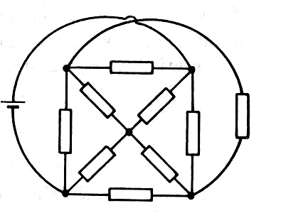
This is definitely non-planar.

Slide 8
Example
Let us consider a simple network having only two meshes.
Although the directions of the mesh currents are arbitrary, we shall always choose clockwise mesh currents.
Note that by taking mesh currents, the KCL is automatically satisfied.

Slide 9
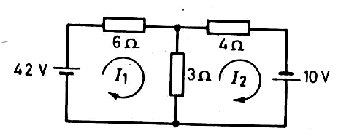
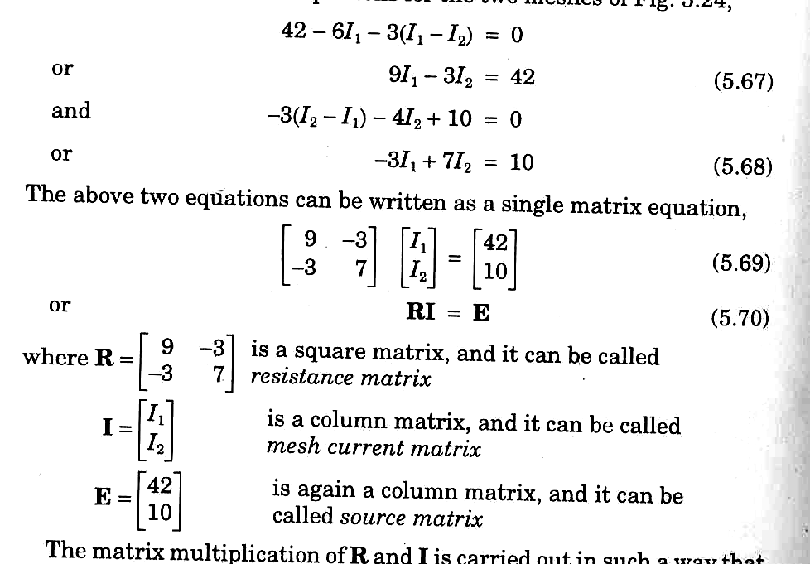

Slide 10
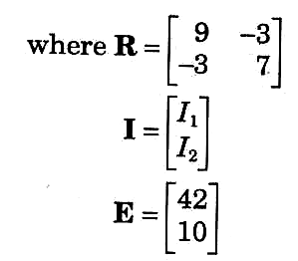
Resistance Matrix
Mesh current matrix
Source matrix

Slide 11
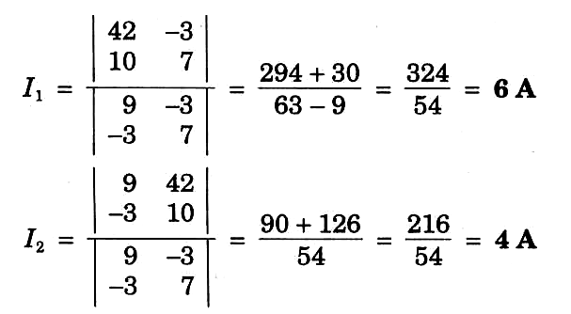
Applying Crammer’s rule :
The current in 3-ohm resistor is I₁ – I₂ = 6 – 4 = 2A

Slide 12
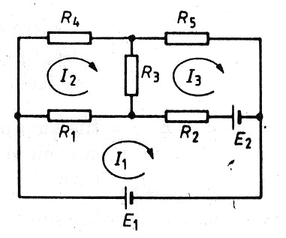
Three-mesh Network
Write the three equations for the three meshes and put them in a matrix form.

Slide 13
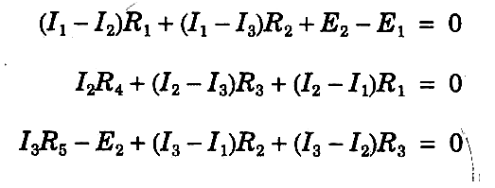
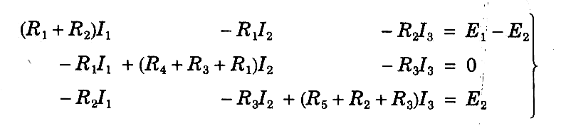

Slide 14
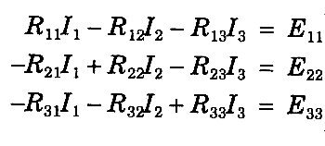
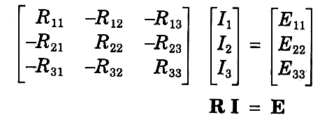

Slide 15
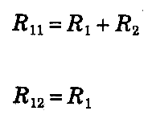

Self-resistance of mesh 1
Mutual resistance
between mesh 1 and 2.

Slide 16
The Resistance Matrix
It is symmetrical about the major diagonal, as R₁₂ = R₂₁, R₁₃ = R₃₁, etc.
All the elements on the major diagonal have positive values.
The off-diagonal elements have negative values.
The mutual resistance between two meshes will be zero, if there is no resistance common to them.

Slide 17
REFERENCES
[1] R.C. Dorf and James A. Svoboda, “Introduction to Electric Circuits”, 9th ed, John Wiley & Sons, 2013.

